Slide 1
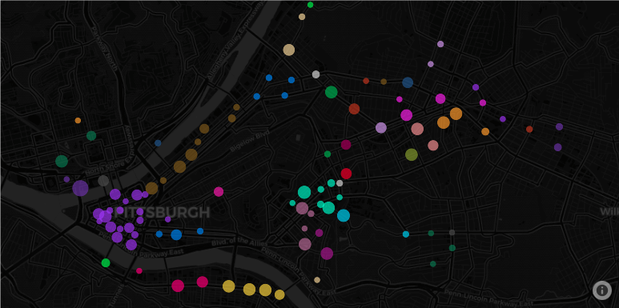

Reducing Discrimination in Learning Algorithms for Social Good in Sociotechnical Systems
Katelyn Morrison
Kmorrison@pitt.edu
Notes:
Hi everyone, my name is Katelyn Morrison and I am a final year undergrad at the University of Pittsburgh studying computer science and sustainability. My recent work focuses on analyzing and brainstorming methods to reduce discrimination in learning algorithms for social good in sociotechnical systems such as smart mobility systems.

Slide 2
Brief Definition of Terms
Learning Algorithms
An algorithm is a set of instructions to complete a given task.
Learning refers to a category of algorithms that are given few discrete instructions and instead are given a framework to learn or identify patterns and trends from a given task to then replicate.
Model is another term for Learning Algorithm
Notes:
Before we get started, I wanted to make sure we are all on the same page with what I mean by Learning algorithms.
Algorithms are broadly a set of discrete instructions whereas learning algorithms identify a type of algorithms that is not given specific instructions to complete a task and instead learn patterns and trends from data to understand how to complete the task.
Model is another term I may use for learning algorithm.
Overall, learning algorithms can be very useful, but they also have their flaws.

Slide 3
Learning Algorithms for Smart Mobility Systems
The Motivation
Turn traditional transit into dynamic, affordable, and on-demand transit systems
Applications
Develop learning algorithms to provide insight and answer questions such as:
Ride sharing, electric bikes, electric scooters, etc.
Where to dispatch taxis & Ubers
Where to build bike stations
Create reliable and sustainable transportation resources for all citizens
Where to redistribute bikes or electric scooters
Predict behaviors and trends over space and time using machine learning models
Notes:
Several learning algorithms have been designed to augment traditional transportation systems into dynamic, affordable, and on-demand systems
such as ride sharing platforms, public bikes, and electric scooters among others. [ANIMATION 1]
These smart mobility systems create reliable and sustainable transportation resources which are vital to the stability and growth of a city. [ANIMATION 2]
To ensure these resources are provided and used efficiently and effectively, researchers have employed learning algorithms that provide insight to help planners and policymakers decide [ANIMATION 4]
where to dispatch taxis or Ubers [ANIMATION 5]
Where to build bike stations [ANIMATION 6]
And where to redistribute bikes or electric scooters in a dockless system throughout a region [ANIMATION 7]
Learning algorithms are fit to tackle these questions by predicting behaviors and trends over space and time [ANIMATION 8]

Slide 4
Discrimination and Biases in Learning Algorithms
Bias in data creates negative feedback loop
Several sources including data collection and algorithmic design
“the demand data on which these models are trained reflect biases around demographics, socioeconomic conditions, and entrenched geographic patterns”
Yan, An, and Bill Howe. "Fairness-Aware Demand Prediction for New Mobility." Proceedings of the AAAI Conference on Artificial Intelligence. Vol. 34. No. 01. 2020.
Collect Data, Clean Data, Exploratory Data Analysis
Prepare Learning Algorithm: “Train” using Data
Evaluate Learning Algorithm through tests using more Data
Deploy Learning Algorithm into real world – generate more data
Adapted by Meg Mitchell
Notes:
Because Learning algorithms LEARN from the data they are given, this can initiate a negative feedback loop in the domain that it is deployed in.
A learning algorithm that learns from a bias dataset will carry those biases throughout and ultimately influence the decisions and behaviors made that help generate more data for the learning algorithm thus reinforcing the original biases that were present in the dataset.
Data collection and algorithmic design are two sources that are typically associated with biases that are embedded in learning algorithm.
As one researcher points out, the demand data on which we train our models reflect biases and in turn impact the outcome of our decisions, behaviors, and generated data.

Slide 5
Planning with Fairness
Planning resource allocation can be framed as an exploration vs exploration problem
Maximize one feature while minimizing another conflicting feature
Maximize resource usage (e.g., bikes) and coverage
Minimize inherent biases
Mathematically, Algorithmically….
Bayesian Optimization
Reinforcement Learning (e.g., Multi-armed bandits)
A planner has several different choices (e.g., actions) each accompanied with a reward (predicted demand).
Planner wants to choose the action that results in the biggest reward
Incorporating fairness into the reward
Notes:
I have been investigating how to allocate resources with fairness in mind.
Planning where to distribute resources puts organizations in an exploration vs exploitation dilemma where we want to maximize one feature such as usage while minimizing another feature such as time and resources spent exploring.
Taking this one step further, I frame this dilemma as maximizing usage and coverage while trying to minimize inherent biases from the data.
It becomes a dilemma when the planner needs to decide how often to explore, where to explore and when to explore a region to place bike stations for example.
This dilemma can be framed mathematically as a Bayesian Optimization problem which allows you to optimize over two conflicting choices.
Going even further, algorithmically this dilemma can be framed as a Reinforcement Learning problem where a planner has several different actions to choose over a time period and each action has a reward which we will define as demand.
The planner will want to choose the action that results in the biggest reward…but the reward is mathematically defined as historical demand, thus bringing us back into a negative feedback loop.
However, modifying this reward to consider fairness allows to predict demand with a fairness constraint which brings me into the work I am completing this semester.

Slide 6
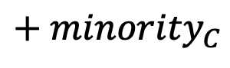
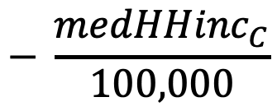
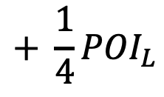
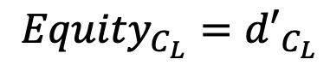
Demand Prediction with Fairness Constraint
Explicitly considers fairness
Develop Equity Score (e.g., reward)
$$+ \frac{1}{4}{POI}_{L}$$
$$− \frac{{medHHinc}_{C}}{100,000}$$
$${Equity}_{C_{L}}={d′}_{C_{L}}$$
$$+ {minority}_{C}$$
The equity score of location L in census tract C
Predicted demand of location L in census tract C
Number of points of interests within ¼ mile radius of location L multiplied by 1/4
Median household income for census tract C divided by 100,000
Percent minority population in census tract C
WORK IN PROGRESS – FEEDBACK WELCOME ☺
Notes:
This semester I aiming to modify the reward to explicitly consider fairness when allocating resources.
To meet this I drafted an equity score (which has not been tested or evaluated to any extent this is quite new as of last week).
The equity score of location L in census tract C is equal to
The predicted demand at the location (nothing new here)
Plus the number of points of interests within 1/4 mile radius of location L multiplied by ¼
Minus the median household income at census tract C divided by 100,000 (this is to penalize census tracts that can purchase their own bike, electric scooter, etc.)
and then plus the % minority in census tract C.
Again this is work in progress and if you feel that there are certain features lacking or certain features that should not be considered in this score, please let me know!
Port Authority - ellie

Slide 7
Discrimination in Smart Mobility Systems
DISCLAIMER
These visualizations are were created from preliminary analyses I did on Pittsburgh’s Healthy Ride system. They are in no way stating or suggesting that organizations have knowingly discriminated against protected features such as demographics or socioeconomic status.
Data Visualization Data Sets:
Health Ride Bike Station Locations from WPRDC
Census Tracts Allegheny County
Census something
Notes:
Before performing any sort of equity audit on smart mobility systems, I generated some preliminary analyses on the Healthy Ride Program in Pittsburgh.
The visualizations I created are in no way stating or suggesting that any organization or stakeholder has knowingly discriminated against protected features.

Slide 8
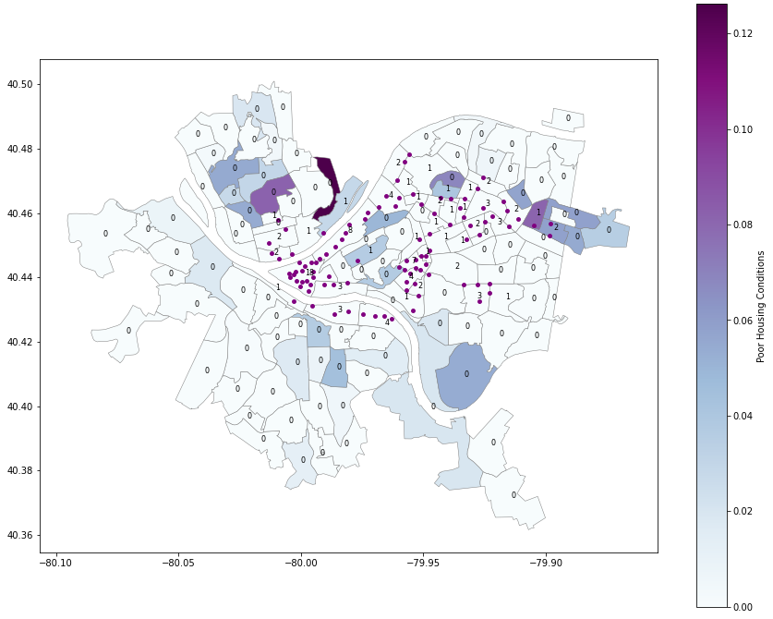
Discrimination in Smart Mobility Systems
Data Visualization Data Sets:
Health Ride Bike Station Locations from WPRDC
Census Tracts Allegheny County
Census something
Notes:
The first question I started with back in April was to understand the relationship between the resources (i.e. the bikes) and the socioeconomic status of the community.
I defined socioeconomic status to be nearly equivalent to the poor housing status of a census tract. Early reviews suggested poor housing conditions cannot be the soul factor to determine socioeconomic status, which is true.
However, the visualization does suggest that the resources have been allocated in census tracts that are not struggling in terms of housing conditions or finances.
You can see several clusters of stations downtown, along the strip district, in Oakland around the three universities, and over near East Liberty/Bakery Square. This is good because the bikes are accessible to jobs, healthcare, and education. But what is missing is those stations that start off in neighborhoods helping people get to the stations in these business districts in the first place.

Slide 9
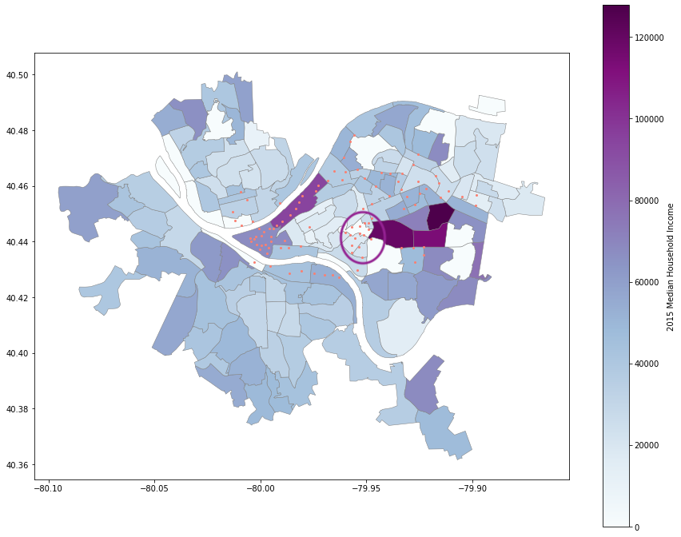
Discrimination in Smart Mobility Systems
Data Visualization Data Sets:
Health Ride Bike Station Locations from WPRDC
Census Tracts Allegheny County
Census something
Notes:
Addressing the reviewers comments I identified for the most part that the resources are in fact allocated in census tracts with a higher income. Circled is an outlier – this highlights campuses and housing for three large universities.

Slide 10
Notes:
Taking a deeper dive into the data, I generated an interactive map using Plotly.
Here you can see the stations colored by census tract and identifies the station’s capacity as well as that census tract’s median household income in 2015. [ANIMATION 1]
The visualization identifies several stations in low and high-income neighborhoods to better understand the spatial and socioeconomic relationships.
Ideally in the future I would love to integrate the equity score and demand prediction into this interactive visualization to be used by transit planners.

Slide 11
Overall Goals
Datasets Used
Healthy Ride Station Locations – WPRDC
Poor Housing Conditions 2016 (Allegheny County) – WPRDC
2020 FFIEC Census Report - Summary Census Income Information
Allegheny County Census Tracts Shapefile
TO BE CREATED: Points of Interests Around Bike Stations
Perform an equity audit using our equity score of the Healthy Ride Bike Share to understand the equity of the bike station locations
Simulate the allocation of resources using the model we develop
Notes:
Datasets that I used to generate these visualizations include the healthy ride station locations, the poor housing conditions from 2016, the 2020 FFIEC census report and the shapefile of Allegheny County Census tracts from 2010
Moving forward, I will be creating at least one new dataset with the help of funding from the Pitt honors college.
The dataset will consist of the current healthy ride station locations along with the points of interests that are within ¼ mile radius as well as how many points of interests to better understand what they are typically surrounded by.
If you think there may be more features that may be helpful to get annotated, let me know.
To sum up my presentation, I hope to accomplish two things this semester
One to be able to perform an audit of the current system to better understand the equity of the bike station locations.
And the second thing consists of allocating resources or at least simulating it with this model.
I am really interested in learning how and if we can join forces on this work moving forward.

Slide 12
Reducing Discrimination in Learning Algorithms for Social Good in Sociotechnical Systems
Katelyn Morrison
Kmorrison@pitt.edu
Notes:
Thank you to Dave for reaching out to me and starting this wonderful connection! I hope that my work can help build a more sustainable Pittsburgh in the process and I would love to hear your comments, critiques, and feedback.
https://spcgis-spc.hub.arcgis.com
come up discrete list of Point of Interests
DC bike share and sanfrancisco

